Slide 2
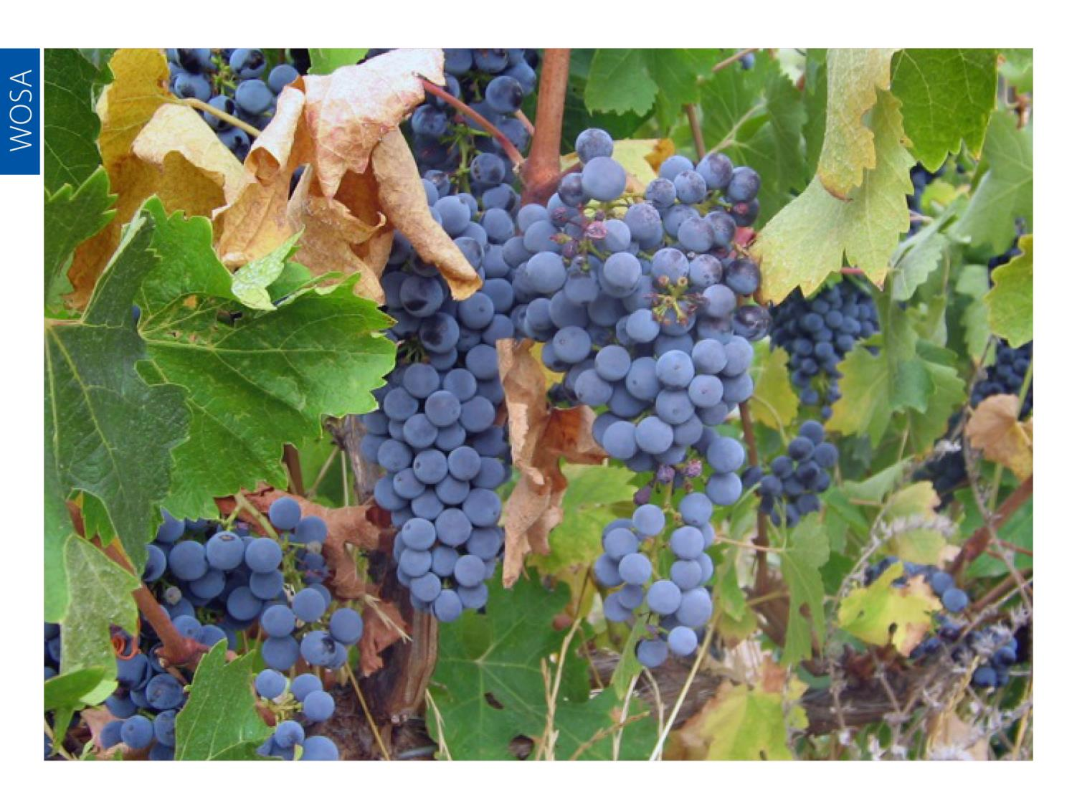
Notes:
Cabernet Sauvignon originated from a spontaneous cross between Cabernet Franc and Sauvignon Blanc, a fact that was only established in 1997, even though this noble variety has been cultivated in France for centuries.

Slide 3
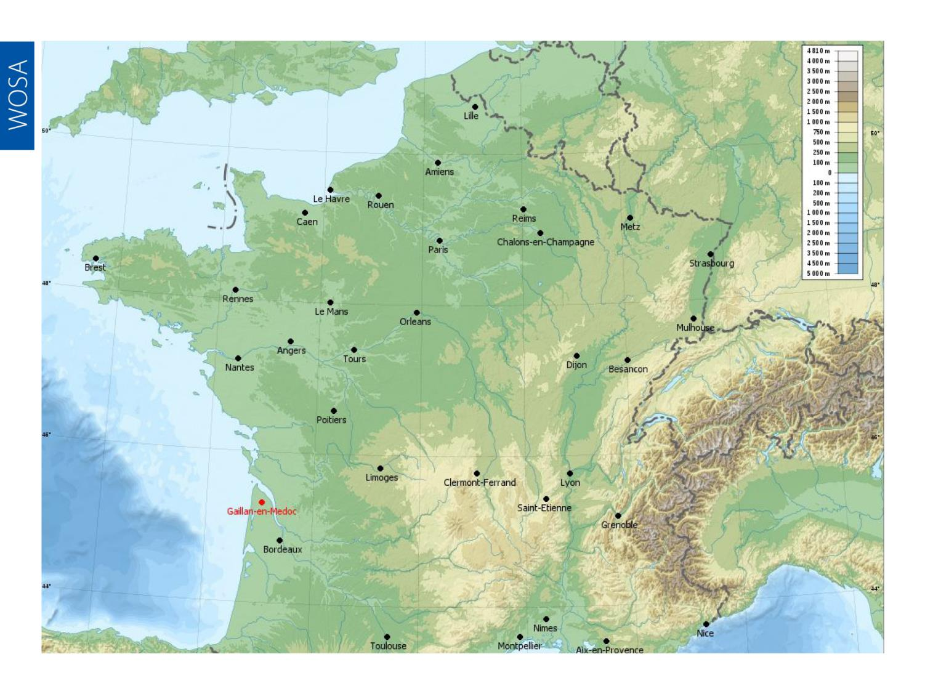
Notes:
In Bordeaux, Cabernet is the principle component in the famous wines of the Médoc.

Slide 4
Notes:
Cabernet Sauvignon is now found all over the world, including in South Africa.

Slide 5
Notes:
It is not clear exactly when Cabernet Sauvignon was first planted in South Africa but it had already been recommended as a suitable variety by Professor Abraham Perold around 1920.

Slide 6
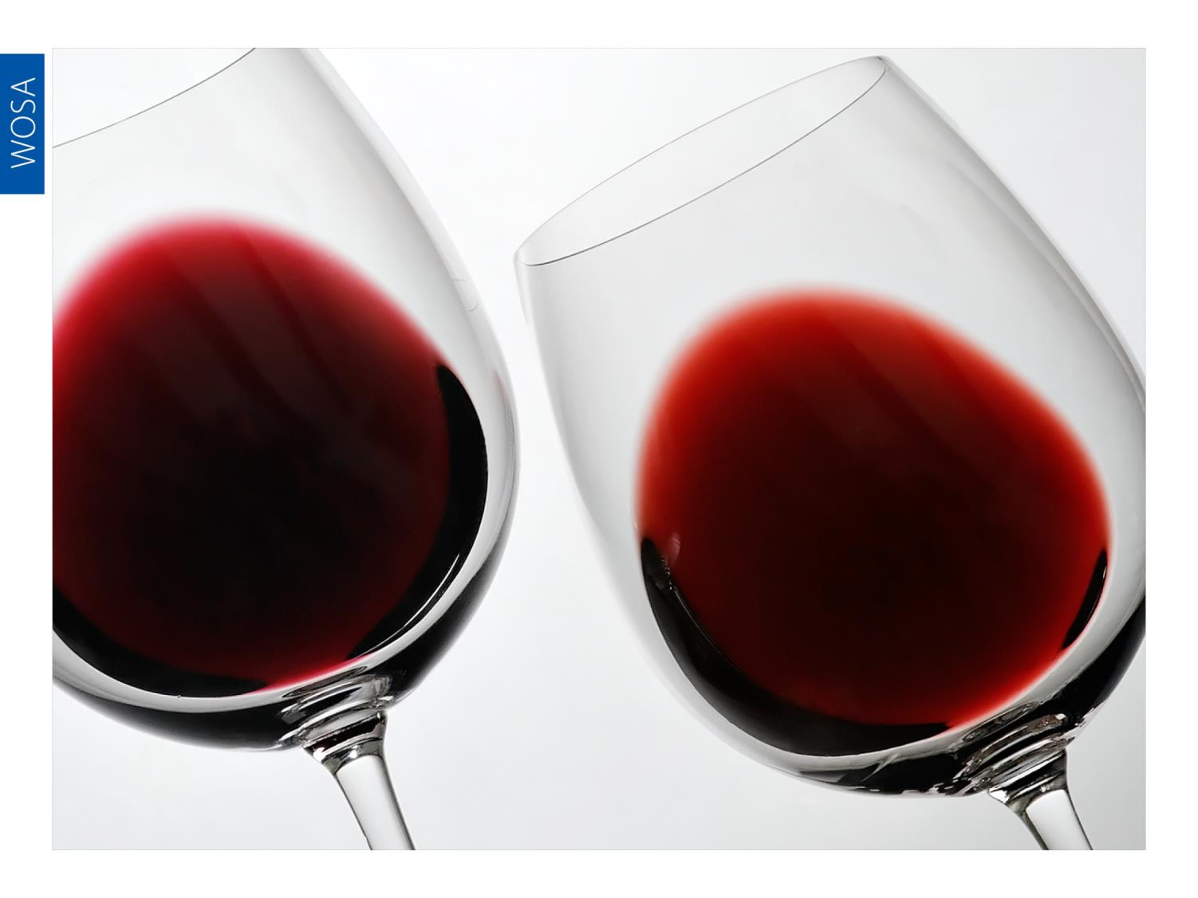
Notes:
Cabernet Sauvignon has become an increasingly significant variety in the Cape, where it produces red wines with excellent colour and good tannins that develop well with age into spicy, full complex wines.

Slide 7
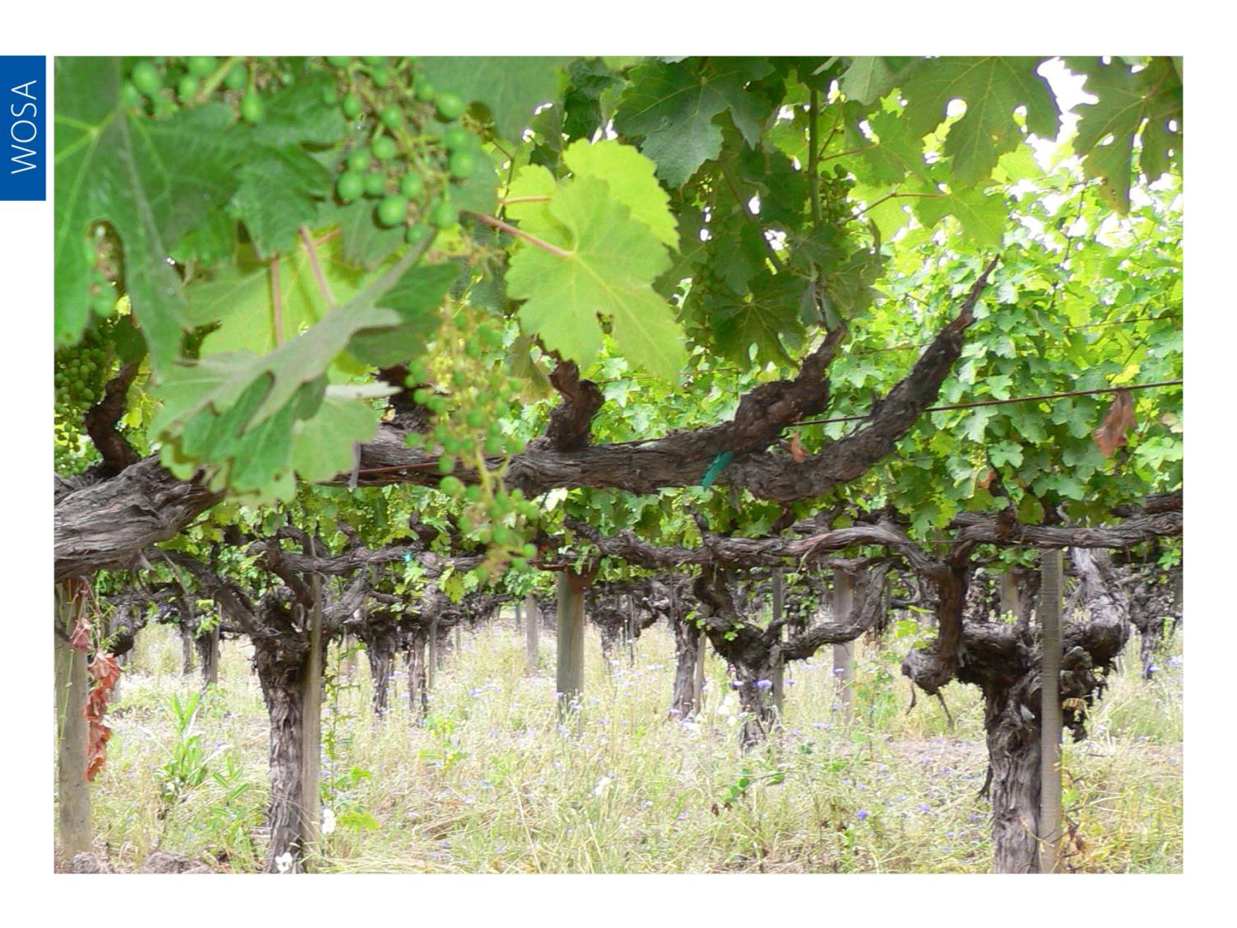
Notes:
Currently Cabernet Sauvignon is the second most planted variety overall (Chenin Blanc takes first position), with total plantings in South Africa at the end of 2013 accounting for 11 658 ha (11.7% of the national vineyard).

Slide 8
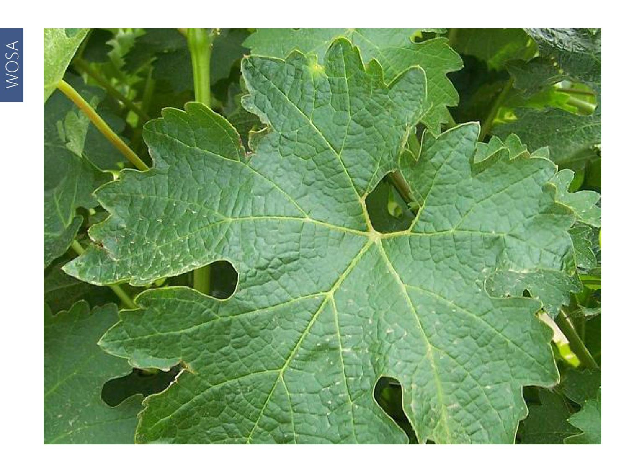
Notes:
Cabernet Sauvignon is the most planted red-wine variety, accounting for over a quarter of the hectarage planted to red-wine varieties. The reason for its popularity is due to its adaptability, as it retains a recognisable character even when planted in less suitable locations.

Slide 9
Notes:
This noble grape variety is grown in almost all the regions of the Cape but most extensively in Stellenbosch and Paarl.

Slide 10
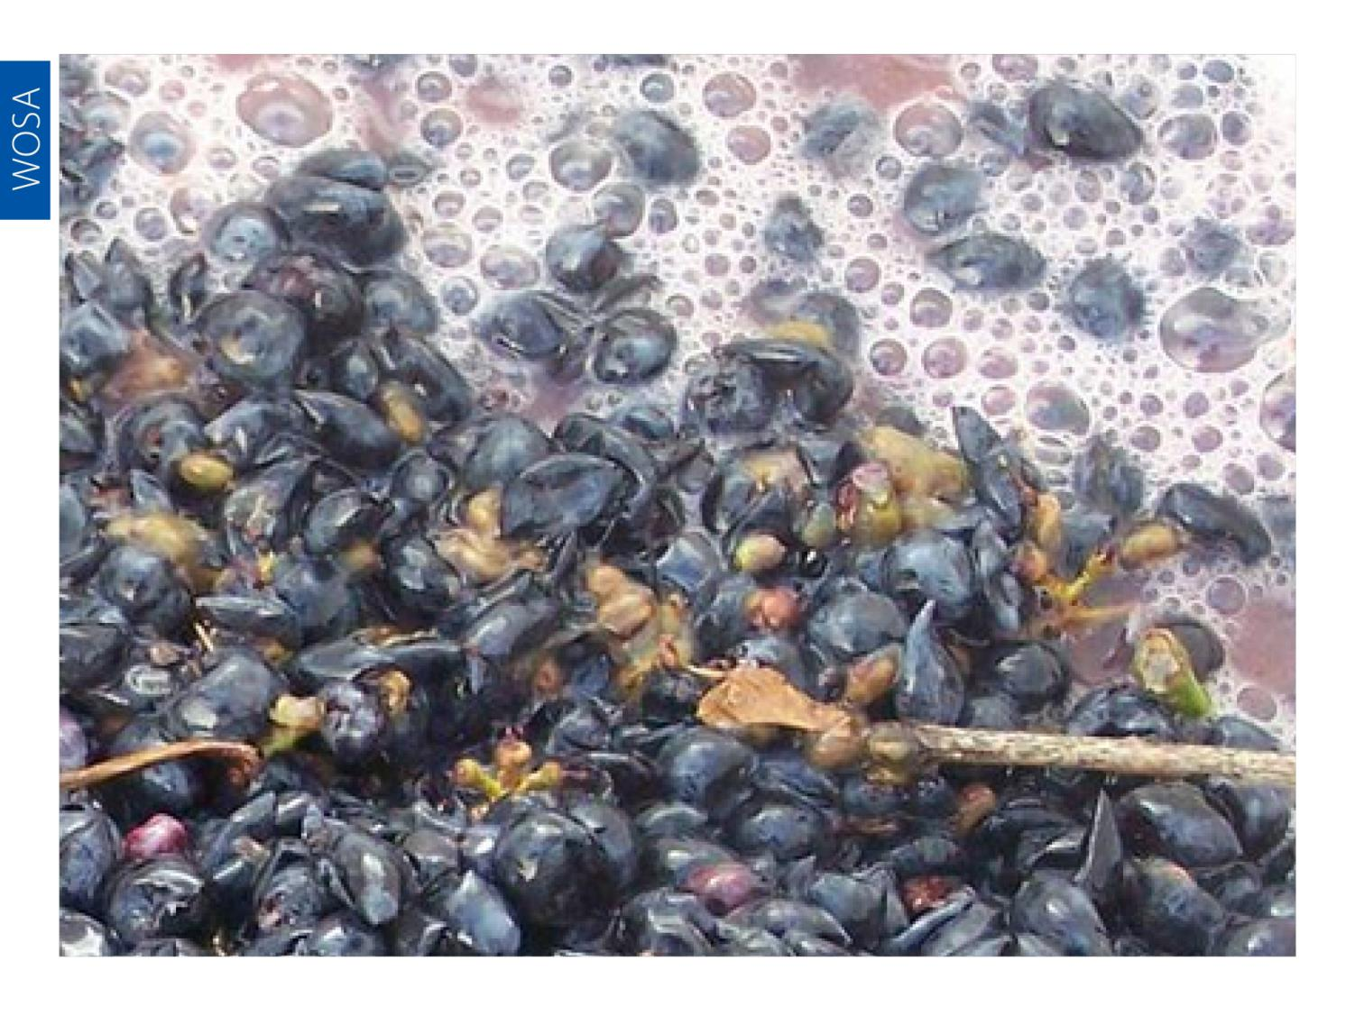
Notes:
There are single varietal expressions of Cabernet that count among South Africa’s very best wines but it is also frequently blended with Merlot and the other traditional Bordeaux varieties, Cabernet Franc, Petit Verdot and Malbec, according to the well-established template of that region (or with Shiraz according to the Australian model).

Slide 11
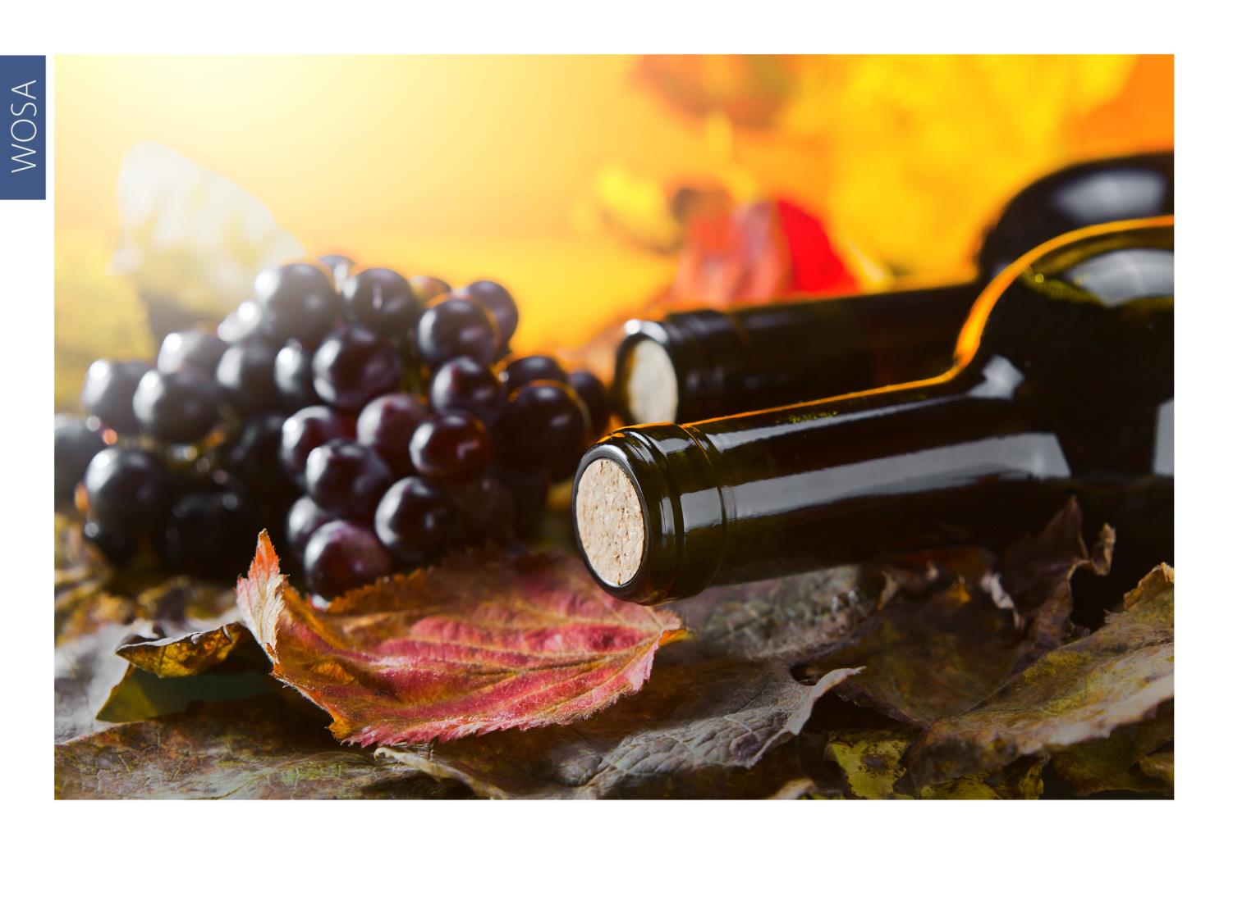
Notes:
South African producers are adept at achieving balance in their wines and there is plenty of pure, clean fruit on display.

Slide 12
Notes:
Rich, smooth and complex, Cabernet’s flavour profile encompasses black cherry, black currant, blackberry and ripe plum, with nuances that can include cassis, cedar, black pepper, tobacco, liquorice, vanilla or violet, and spiciness from the oak.

Slide 13
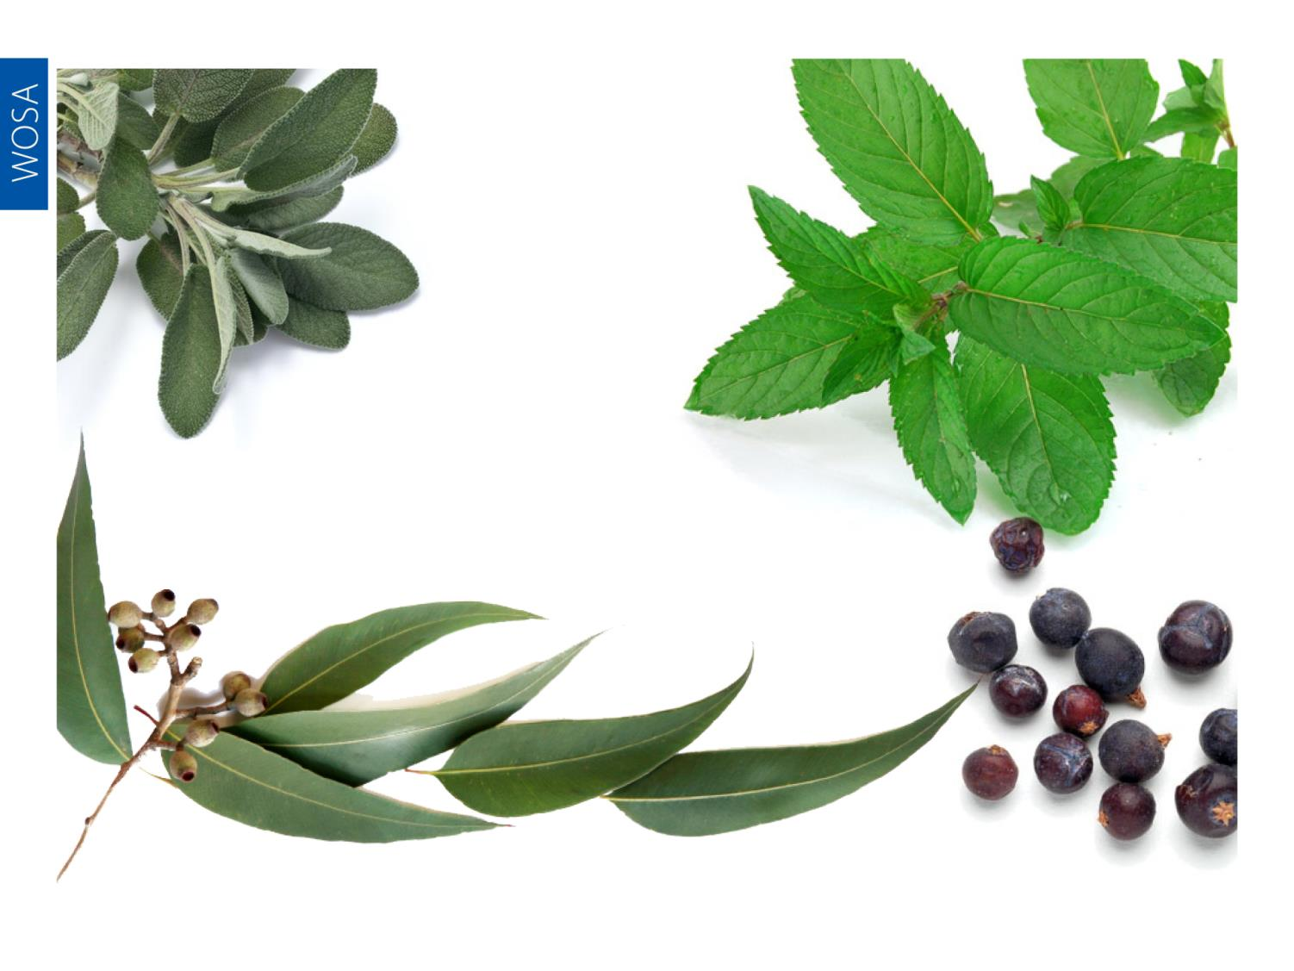
Notes:
In South Africa, an extensive range of clones produces a broad range of characteristics such as berry, eucalyptus and even mint from newer clones. Wines from older clones may be more herbaceous in character.

Slide 14
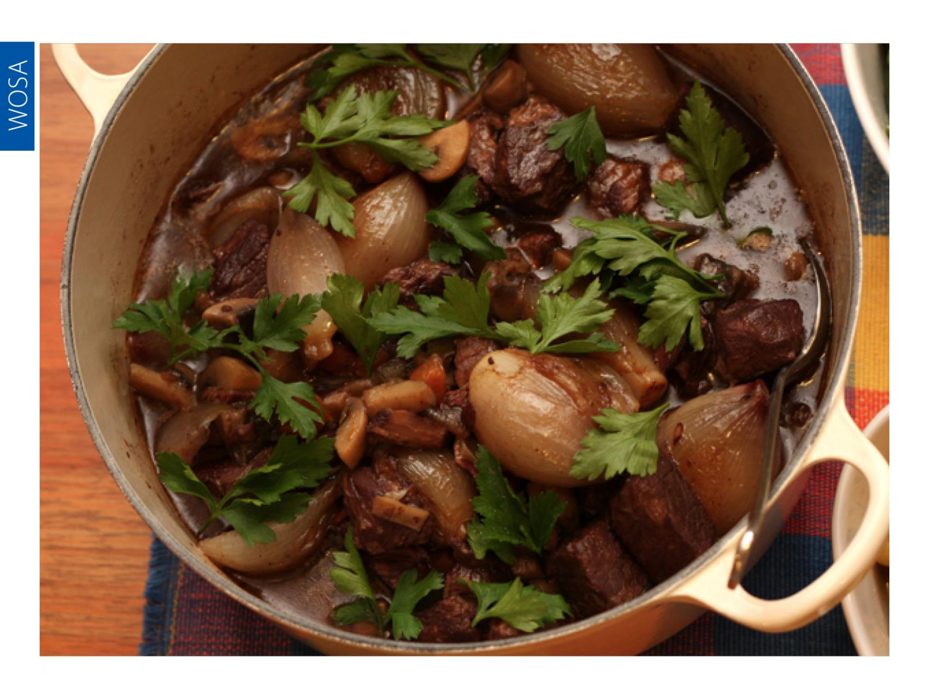
Notes:
Full-bodied Cabernet pairs well with meaty dishes, from roast beef or boeuf bourguignon to venison casseroles and oxtail stew.

